Slide 1
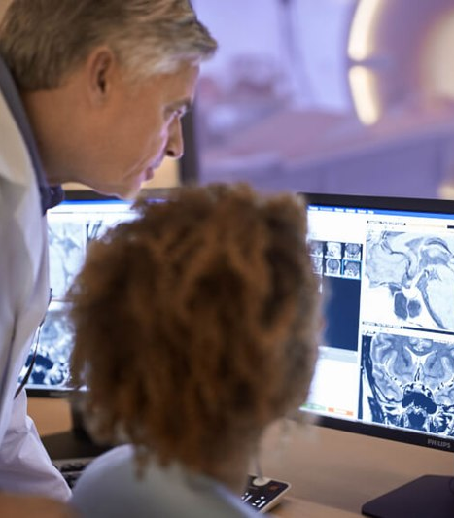

www.acoredu.com

Slide 2

Dane Eskildsen DO
Baylor College of Medicine

Slide 3

WHAT’S NEW IN:
Gastrointestinal Imaging
Reviewed By:
Vincent Mellnick, Senior Editor
Alice Fung, Senior Editor
Dane Eskildsen DO, Junior Editor
Richard Fagan MD, Junior Editor

Slide 4
Low-dose Abdominal CT for evaluating suspected appendicitis in adolescents and young adults: review of evidence
Park JH, Salminen P, Tannaphai P, Lee KH. Low-Dose Abdominal CT for Evaluating Suspected Appendicitis in Adolescents and Young Adults: Review of Evidence. Korean J Radiol. 2022 May;23(5):517-528. https://doi.org/10.3348/kjr.2021.0596
Concerns for carcinogenic risk of CT, particularly in pediatric/adolescent populations.
Low dose CT (LDCT) an option to mitigate these risks.
This review article aims to assess evidence for use of LDCT for diagnosis of appendicitis.
Reviews multiple aspects of CT, including dose, carcinogenic risks, LDCT vs Conventional dose CT (CDCT) throughout the literature.
Authors found compelling evidence that LDCT is comparable to CDCT for diagnosis of acute appendicitis.

Slide 5
Predictors of transmural intestinal necrosis in patients presenting with acute mesenteric ischemia on computed tomography
Atre, I.D., Eurboonyanun, K., O’Shea, A. et al. Predictors of transmural intestinal necrosis in patients presenting with acute mesenteric ischemia on computed tomography. Abdom Radiol 47, 1636–1643 (2022). https://doi.org/10.1007/s00261-020-02558-8
Insufficient bowel blood flow -> Acute mesenteric ischemia (AMI) -> necrosis
Physical/lab findings not sens/spec thus imaging important.
Retrospective case-control: 48 patients with AMI, 26 with transmural necrosis
Most significant predictors of transmural necrosis after AMI: Vascular occlusion >70% and pneumatosis intestinalis.
Findings which did NOT predict necrosis: Fat stranding, ascites, presence or absence of ostial stenosis, # of vessels involved, length of occlusion

Slide 6
CT Enterography Using Four Different Endoluminal Contrast Agents: A Comparative Study
Singla, D., Chandak, S., et al CT Enterography Using Four Different Endoluminal Contrast Agents: A Comparative Study J of Gast and Abd Radiol, 2022-01, Vol.5 (1), p.016-022
CT enterography (CTE) used to diagnose small bowel pathology
Oral contrast agents: Positive vs. Negative, which agent is best?
Water (-), polyethylene glycol (PEG) (-), mannitol (-), iohexol (+)
120 patients underwent CTE, 30 patients per contrast agent
Evaluated: distention, bowel morphology, image quality, patient tolerability
PEG superior in all categories, minus tolerability.

Slide 7
Algorithmic Approach to the Splenic Lesion Based on Radiologic-Pathologic Correlation
Kim, N., Auerbach, A. and Manning, M., 2022. Algorithmic Approach to the Splenic Lesion Based on Radiologic-Pathologic Correlation. RadioGraphics, 42(3), pp.683-701.
Splenic masses uncommon, often incidental.
Usually benign, however malignant masses important to differentiate
Proposed algorithmic approach to splenic masses, with focus on Rad-path
Masses divided into cystic vs. Solid --> Solitary vs. Multiple (Image 1, next slide)
Solitary solid masses further divided: Vascular vs. Nonvascular
Various splenic masses described within the article.

Slide 8
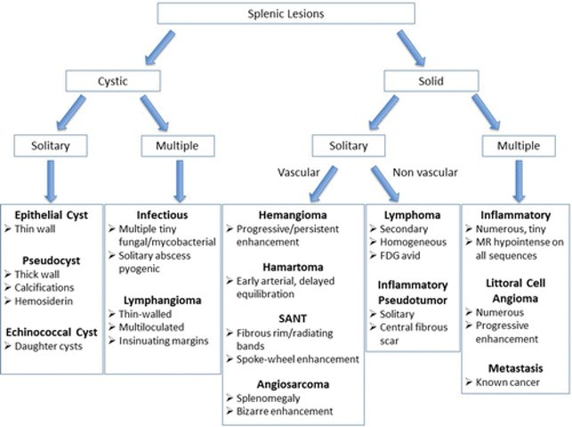
Image 1

Slide 9
Colorectal Cancer: Performance and Evaluation for CT Colonography Screening— A Multicenter Cluster-randomized Controlled Trial
Obaro AE, Plumb AA, Halligan S, et al. Colorectal Cancer: Performance and Evaluation for CT Colonography Screening—A Multicenter Cluster-randomized Controlled Trial. Radiology 2022;303(2):361–370.
CT colonography (CTC): alternative screen for colorectal cancer and polyps.
In UK: no requirement for radiologist performance accreditation for CTC
Can 1-day individualized CTC training improve sensitivity?
Two trial arms: Intervention (received 1 day training), Control (no training).
Participants interpreted 40 unique CTCs (10 at baseline, then 10 at 1, 6 and 12 months, respectively.
Radiologists who received training had improved diagnostic sensitivity at all time intervals. Experienced Radiologists had a 16.7% increase in detection of colorectal lesions.

Slide 10




@ACOREdu
@ACOREdu
@ACOREdu
www.acoredu.com

