Slide 1
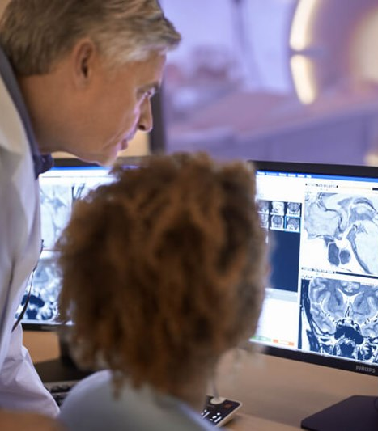

www.acoredu.com

Slide 2
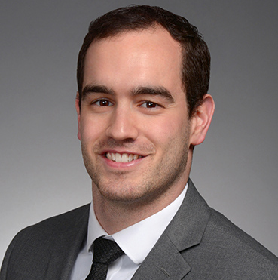

Richard Fagan, MD
Baylor College of Medicine

Slide 3

WHAT’S NEW IN:
GI Imaging
Reviewed By:
Senior editor 1
Senior editor 2
etc

Slide 4
Abdominal imaging findings on computed tomography in patients acutely infected with SARS‑CoV‑2: what are the findings?
Michio Taya. Viktoriya Paroder. Gil Redelman‑Sidi. Natalie Gangai. Jennifer S. Golia Pernicka. Marc J. Gollub. Sidra Javed‑Tayyab. Iva Petkovska. David D. B. Bates. Emergency Radiology (2021) 28:1087–1096.
Aim to identify GI findings of COVID-19 using contrast enhanced CT abdomen/pelvis
Cancer patients diagnosed with scan 3 days before to 45 days after COVID diagnosis
COVID uses ACE2 receptor for alveolar cell entry, also found in GI tract
Thickening of GI tract in 22%, small volume ascites in 14.3%, gallbladder distension in 7%, 1.6% acute pancreatitis, 1.6% portal vein thrombosis
Only 16% had a GI complaint on presentation

Slide 5
Prediction of epithelial-to-mesenchymal transition molecular subtype using CT in gastric cancer
Dong Ik Cha, Jeeyun Lee, Woo Kyoung Jeong, Seung Tae Kim, Jae-Hun Kim, Jung Yong Hong, Won Ki Kang, Kyoung-Mee Kim, Seon Woo Kim, Dongil Choi. European Radiology (2022) 32:1–11
Attempt to make a CT based prediction model and a nomogram for individualized estimation of epithelial-to-mesenchymal transition (EMT) subtype gastric cancers
Aberrant gastric EMT activation can lead to more aggressive features in gastric cancers
Gene expression profiling is expensive and not implemented routinely
Models developed by the authors: using CT AUC of 0.865, not using CT AUC of 0.750
Guide utilization of gene expression profiling in patients with high probability of EMT subtype

Slide 6
Automatic detection of Crohn’s disease using quantified motility in magnetic resonance enterography: initial experiences
A. Arkko, T. Kaseva, E. Salli, T. M€akel€a, S. Savolainen, M. Kangasniemi. Clinical Radiology 77 (2022) 96-103
MRE used for disease extent and severity in CD, but not often used for primary diagnosis
Study used free breathing MRE to quantify intestinal motility to detect CD
302 patients at 2 tertiary centers, not excluded for co-existing GI conditions
Compared ROI of small bowel, all bowel, non-bowel, and full image. Used multiple cine times.
Highest AUC (0.78) using the full image ROI with the highest cine series length

Slide 7
Retrospective Assessment of the Impact of Primary Language Video Instructions on Image Quality of Abdominal MRI
Myles T. Taffel, MD, Andrew B. Rosenkrantz, MD, Jonathan A. Foster, MD, Jay A. Karajgikar, MD, Paul N. Smereka, MD, Felicia Calasso, Kun Qian, MS, Hersh Chandarana, MD. J Am Coll Radiol 2021;18:1635-1642
Minimizing respiratory motion artifact requires communication between technologist and patient
Mandarin Chinese/Spanish instructional video before MRI for ESL patients, compared with no video ESL group and English-speaking group
ESL w/o native language video had sig lower scores for T2WI respiratory motion and overall image quality than others
T1WI respiratory motion and overall image quality were not statistically different between the groups
T2WI requires instructions during scan, T1WI acquired more rapidly

Slide 8
Postoperative complications of colorectal cancer
Yacoub JH, Clark JA, Paal EE, Manning MA. Radiographics 2021; 41: 1368-1386
CRC 3rd most common cancer, surgery usually performed
Surgical approaches and techniques reviewed
Post operative complications and imaging features reviewed
Important to recognize these complications and to be able to distinguish them from tumor recurrence

Slide 9




@ACOREdu
@ACOREdu
@ACOREdu
www.acoredu.com

