Slide 1
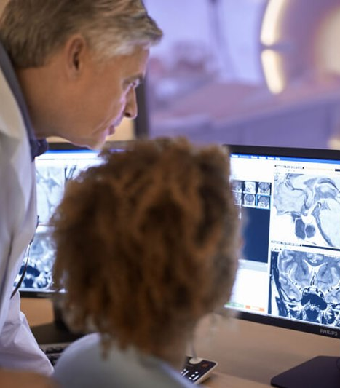

www.acoredu.com

Slide 2

Dane Eskildsen DO
Baylor College of Medicine

Slide 3

WHAT’S NEW IN:
Gastrointestinal Imaging
Reviewed By:
Vincent Mellnick, Senior Editor
Alice Fung, Senior Editor
Dane Eskildsen DO, Junior Editor
Richard Fagan MD, Junior Editor

Slide 4
Revisiting the Spleen—An Imaging Review of the Common and Uncommon Splenic Pathology
Nadeem, Meshaal ; Tiwari, Hina Arif ; Jambhekar, Kedar ; Shah, Hemendra ; Ram, Roopa Journal of Gastrointestinal and Abdominal Radiology, 2021-07, Vol.4 (2), p.127-138
Splenic anatomy, imaging characteristics, anatomic variants
Traumatic injuries
Vascular pathology
Infectious/inflammatory
Benign and malignant masses

Slide 5
Evaluation of celiac disease with uniphasic and multiphasic dynamic MDCT imaging
Göya, Cemil; Dündar, İlyas Özgökçe, Mesut; Türkoğlu, Saim; Türko, Ensar; Özkaçmaz, Sercan; Aydoğdu, Güly; Almalı, Necat. Abdominal radiology (New York), 2021-08-20, Vol.46 (12), p.5564-5573
Contrast enhanced MRI gives useful info about celiac disease (CD)
Can CECT do the same?
4 patient groups analyzed (untreated CD, Treated CD, CD resistant to treatment, Patients without CD)
Contrast curve similarities and differences between groups.
Dynamic MDCT useful in follow up of dietary therapy/response to medical treatment

Slide 6
Overview of serum and tissue markers in colorectal cancer: a primer for radiologists
Bonde, Apurva; Smith, Daniel A; Kikano, Elias; Yoest, Jennifer M; Tirumani, Sree H; Ramaiya, Nikhil H
Abdominal radiology (New York), 2021-08-20, Vol.46 (12), p.5521-5535
Role in diagnosis/management of CRC
Serological/Tissue markers
Screening, early diagnosis, treatment response, recurrence, prognosis.
Serial CEA elevation warrants imaging follow up.
Consider tumor markers when evaluating images
Investigative imaging biomarkers

Slide 7
Radiology of anal and lower rectal cancers
Hemachandran, N ; Goyal, A ; Bhattacharjee, H.K ; Sharma, R. Clinical radiology, 2021-12, Vol.76 (12), p.871-878
Anatomy/imaging characteristics
Types and characterization of lower rectal/anal cancers
Use of imaging - CT, MRI, endoanal US, FDG-PET
MRI technique/features
Treatment/post-imaging

Slide 8
Body mass index as a predictor of sonographic visualization of the pediatric appendix
Pfeifer, Cory M ; Xie, Luyu ; Atem, Folefac D ; Mathew, M. Sunil ; Schiess, Desi M ; Messiah, Sarah E. Pediatric radiology, 2021-09-15, Vol.52 (1), p.42-49
Ultrasound for appendicitis in pediatric patients
Increased BMI said to limit US
BMI converted to Z-score
Inverse linear relationship between BMI and visualization
Z score < -2: 4.41x more likely, Z score 1-2 and >2: 33% and 66% less likely
Higher visualization for male patients

Slide 9




@ACOREdu
@ACOREdu
@ACOREdu
www.acoredu.com

