Slide 1
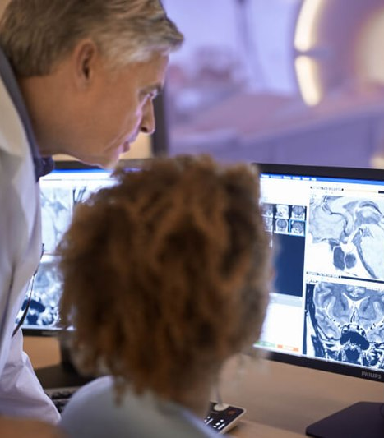

www.acoredu.com

Slide 2


Richard Fagan, MD
Baylor College of Medicine

Slide 3

WHAT’S NEW IN:
GI Imaging
Reviewed By:
Senior editor 1
Senior editor 2
etc

Slide 4
Correlation of gastrointestinal perforation location and amount of free air and ascites on CT imaging
Drakopoulos D, Arcon J, Freitag P, El-Ashmawy M, Lourens S, Beldi G, Obmann VC, Ebner L, Huber AT, Christe A. Abdominal Radiology 2021 46:4536-4547
Aim to localize GI perforation using volume of free air and ascites
Significantly more ascites seen with upper GI perforation, avg of 333 mL
Significantly more free air seen in stomach, descending & sigmoid colon perforation
2 step algorithm using free air and ascites volume to indicate likely site of perforation

Slide 5
The CT scout view: complementary value added to abdominal CT interpretation
Lee MH, Luber MG, Mellnick VM, Menias CO, Bhalla S, Pickhardt PJ. Abdominal Radiology 2021. 46:5021-5036
Scout views include areas not included on full CT
Medicolegal standard is to review all images submitted
Authors found up to 2% of scouts have findings not included in the CT
Scouts may have reduced artifact compared to CT for some findings

Slide 6
Diagnostic utility of computed tomography in patients presenting to the emergency department with unintended weight loss
Rao S, Kikano EG, Smith DA, Tirumani SH, Ramaiya NH. Emergency Radiology (2021) 28: 771-779
Patients with at least 5% body weight unintentionally lost over 6 months
Non-malignant GI condition in 31%, most commonly chronic pancreatitis
Malignancy in 23%, most common primaries: lung, colon, pancreas
Cause for weight loss identified in 48% of patients

Slide 7
CT for lymph node staging of Colon cancer: not only size but also location and number of lymph node count
Hong EK, Landolfi F, Castagnoli F, Park SJ, Boot J, Van den Berg J, Lee JM, Beets-Tan R. Abdominal Radiology (2021) 46:4096-4105
Currently no accurate radiological criteria for lymph node status
Largest short diameter (>7.95 mm), internal heterogeneity most significant
Total # of nodes, # in peritumoral area, # along mesenteric vessels significant
No significant association between short/long axis ratio of >0.8

Slide 8
Approach to Cystic Lesions in the Abdomen and Pelvis, with Radiologic-Pathologic Correlation
Yacoub JH, Clark JA, Paal EE, Manning MA. Radiographics 2021; 41: 1368-1386
Highlights imaging characteristics of cystic lesions of GI tract
Cyst contents, locularity, wall thickness, internal complexity and enhancement most important features
Discusses utility and shortcomings of each imaging modality in cyst diagnosis
Common mimics and management

Slide 9




@ACOREdu
@ACOREdu
@ACOREdu
www.acoredu.com

