Slide 1
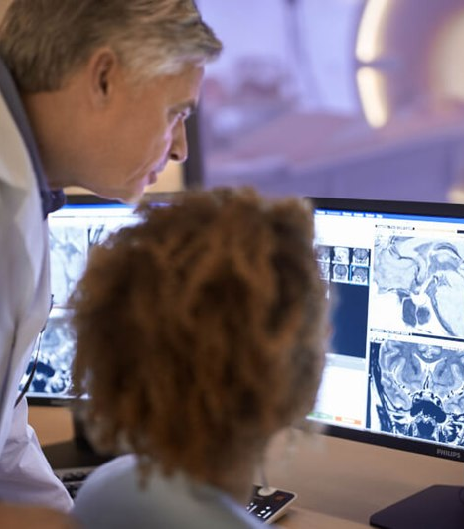

www.acoredu.com

Slide 2



Mindy Wang, MD
University of Texas at Houston

Slide 3

WHAT’S NEW IN:
Ultrasound
Reviewed by:
Aya Kamaya, MD
Eduardo Matta, MD
David Fetzer, MD
Shweta Bhatt, MBBS, MD

Slide 4
Contrast-enhanced Ultrasonography Promotes Differential Diagnosis of Ureteral Neoplasms
Yun Bai, Jun Lin, An Chen, Min Bai, Chunxiao Li, Yingyu Cai, Jie Yu, Wenjie Hu, Lianfang Du, Fan Li
Is CEUS a helpful imaging modality in evaluating ureteral urothelial carcinomas (UCC)?
Retrospective study of 39 patients who underwent US, CEUS, and CT urography
  27 ureteral malignancies confirmed on pathology
CEUS features
  Malignancy: hyperenhancement, larger width, hyperenhanced ureteric wall
  Benign tumors: iso/hypoenhanced, narrower, iso/hypoenhanced ureteric wall
 | Sensitivity | Specificity
B-ultrasound | 66.67% | 41.67%
CEUS | 100.00% | 83.33%

Slide 5
Role of Contrast-enhanced Ultrasound in Assessing Indeterminate Renal Lesions and Bosniak ≥2F Complex Renal Cysts Found Incidentally on CT or MRI
Giuseppe Como, Claudio Valotto, Francesco Tulipano Di Franco, Gianluca Giannarini, Lorenzo Cereser, Rossano Girometti, Chiara Zuiani
Can CEUS help reclassify indeterminate lesions (IL) or Bosniak 2F complex renal cysts (CRC) initially found on CT or MRI?
Retrospective study of 44 patients who underwent CEUS to further assess incidentally found renal lesions on prior CT or MRI
CEUS reclassified 24/48 findings, including 12/12 IL and 12/36 CRC
CEUS demonstrated 96% sensitivity and 82.6% specificity; CT/MRI demonstrated 82.6% sensitivity and 60.9% specificity

Slide 6
Cystic Artery Velocity as a Predictor of Acute Cholecystitis
Marcelina G. Perez, Justin R. Tse, Kristen N. Bird, Tie Liang, R. Brooke Jeffrey, Aya Kamaya
Can angle-corrected peak systolic cystic artery velocity (CAv) serve as a predictor for acute cholecystitis?
Retrospective study of patients who presented to the ED with right upper quadrant pain and underwent cystic artery measurement and definitive treatment
  43 patients underwent definitive treatment
  30 control patients without clinical suspicion for cholecystitis
CAv ≥40 cm/sec is highly associated with acute cholecystitis
 | Acute cholecystitis | Chronic cholecystitis | Control
Average CAv (cm/sec) | 50 ± 16 | 28 ± 8 | 22 ± 8

Slide 7
Ultrasound Liver Imaging Reporting and Data System (US LI-RADS) Visualization Score: A Reliability Analysis on Inter-reader Agreement
Thodsawit Tiyarattanachai, Kristen N. Bird, Edward C. Lo, Aladin T. Mariano, Amanzo A. Ho, Craig W. Ferguson, Ranjit S. Chima, Terry S. Desser, Linda Nayeli Morimoto, Aya Kamaya
What is the inter-reader agreement for US LI-RADS Visualization Score?
Retrospective study of 90 US HCC screening and surveillance studies with 30 studies in each Visualization category
Score | Concept | Examples
Visualization A. No or minimal limitations | Limitations, if any, are unlikely to meaningfully affect sensitivity | Liver homogeneous or minimally heterogeneous Minimal beam attenuation or shadowing Liver visualized in near entirety
Visualization B. Moderate limitations | Limitations may obscure small masses | Liver moderately heterogeneous Moderate beam attenuation or shadowing Some portions of liver or diaphragm not visualized
Visualization C. Severe limitations | Limitations significantly lower sensitivity for focal liver lesions | Liver severely heterogeneous Severe beam attenuation or shadowing Majority (>50%) of liver not visualized Majority (>50%) of diaphragm not visualized

Slide 8
Feasibility and Safety of Neonatal Brain Contrast-Enhanced Ultrasound: A Prospective Study Using MRI as Reference Standard
Judy H. Squires, Nancy H. Beluk, Vince K. Lee, Toby D. Yanowitz, Serter Gumus, Subramanian Subramanian, Ashok Panigrahy
Is transfontanelle CEUS a feasible, safe, and diagnostic modality to assess the neonatal brain compared to MRI?
Prospective study of 26 neonates in NICU who underwent MRI, portable brain US, and CEUS
Abnormality on CEUS | Sensitivity | Specificity
Acute or subacute ischemia Chronic ischemia | 87.5% | 100.0%
Chronic ischemia | 100.0% | 95.8%
Subdural hemorrhage | 33.3% | 100.0%
Intraparenchymal hemorrhage | 50.0% | 100.0%

Slide 9
Cranial US in Infants Exposed to Zika Virus: The NATZIG Cohort
Sara Reis Teixeria, Jorge Elias Jr, Conrado Milani Coutinho, Maria Clara Zanon Zotin, Aparecida Yulie Yamamoto, Silvia Fabiana Biason de Moura Negrini, Marisa Márcia Mussi-Pinhata
What are the US features of prenatal Zika virus exposure? How frequent are these findings in infants exposed to Zika virus compared to control infants?
Prospective study of infants during December 2015-January 2016 outbreak of Zika virus infection
  Brain US of infants with prenatal Zika virus exposure compared to those without Zika virus exposure
Lenticulostriate vasculopathy – common mild finding in infants with prenatal exposure to Zika virus

Slide 10
US Velocimetry in Participants with Aortoiliac Occlusive Disease
Stefan Engelhard, Majorie van Helvert, Jason Voorneveld, Johan G. Bosch, Guillaume P. R. Lajoinie, Michel Versluis, Erik Groot Jebbink, Michel M. P. J. Reijnen
Can high-frame-rate-CEUS (HFR-CEUS) and particle image velocimetry (PIV) help quantify blood flow in aortoiliac arteries in patients with aortoiliac stenosis?
Prospective study of 35 patients with aortoiliac stenosis
  HFR-CEUS measurements of pre- and post-stenotic vessel segments
  PIV analysis for quantification of blood flow
Flow quantification achieved using PIV in 41 of 42 locations
Flow complexity and vorticity were high in regions with disturbed flow

Slide 11
Axillary Nodal Metastases in Invasive Lobular Carcinoma versus Invasive Ductal Carcinoma: Comparison of Node Detection and Morphology by Ultrasound
Hannah L. Chung, Hilda H. Tso, Lavinia P. Middleton, Jia Sun, Jessica W. T. Leung
What is the detection rate of metastatic axillary lymph nodes? What are their US features in invasive lobular carcinoma compared with invasive ductal carcinoma?
Retrospective study of 695 patients with breast cancer with total 723 breasts with biopsy-proven axillary nodal metastases
  Classified suspicious lymph nodes
  Compare lymph nodes between lobular and ductal carcinoma
Detection rate: 80.3% for lobular carcinoma, 88.7% for ductal carcinoma
US features of lobular carcinoma metastatic nodes: diffuse cortical thickening without hilar mass effect

Slide 12




@ACOREdu
@ACOREdu
@ACOREdu
www.acoredu.com

