Slide 1
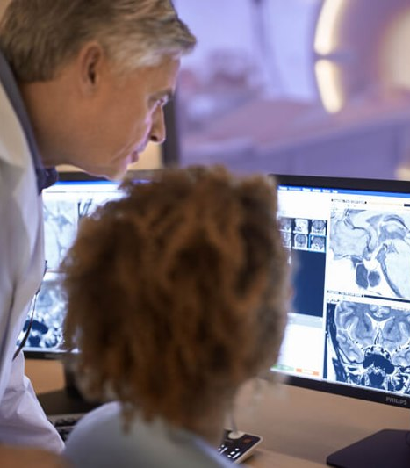

www.acoredu.com

Slide 2

Dane Eskildsen DO
Baylor College of Medicine

Slide 3

WHAT’S NEW IN:
Gastrointestinal Imaging
Reviewed By:
Vincent Mellnick, Senior Editor
Alice Fung, Senior Editor
Dane Eskildsen DO, Junior Editor
Ricky Fagan MD, Junior Editor

Slide 4
Gastrointestinal Tract Dilatations: Why and How They Happen—A Simplified Imaging Classification
Alberto I. Carbo, Nour Nakrour, Silvia Barbeito, Maria L. Gregorio, Atefeh Geimadi, and Juan S. Gomez. Gastrointestinal Tract Dilatations: Why and How They Happen—A Simplified Imaging Classification. RadioGraphics 2021 41:6, E175-E176
Causes of GI dilatations can be classfied as atonic, closed loop obstructions, simple obstructions and localized obstructions.
Each class will have its own imaging charactaristics.
Imaging helps to localize, differentiate between and estimate the severity of obstructions.

Slide 5
Can Patient Triaging with Clinical Scoring Systems Reduce CT Use in Adolescents and Young Adults Suspected of Having Appendicitis?
Song et al. Can Patient Triaging with Clinical Scoring Systems Reduce CT Use in Adolescents and Young Adults Suspected of Having Appendicitis? Radiology 2021 300:2, 350-358
Clinical scoring model vs. CT for appendicitis.
CT for suspected appendicitis: Sensitivity 98%, Specificity 95%.
Different scoring systems evaluated at target sensitivity/specificity had CT reduction rates of 0%.
CT superior to all scoring systems.

Slide 6
Conventional-Dose CT Versus 2-mSv CT for Right Colonic Diverticulitis as an Alternate Diagnosis of Appendicitis: Secondary Analysis of Large Pragmatic Randomized Trial Data
Kim HY et. Al. Conventional-Dose CT Versus 2-mSv CT for Right Colonic Diverticulitis as an Alternate Diagnosis of Appendicitis: Secondary Analysis of Large Pragmatic Randomized Trial Data.
American Journal of Roentgenology. 2021 217:5, 1113-1121
Right colonic diverticulitis vs. Appendicitis.
Low dose (2 mSv CT) for detecting appendicitis, hesitancy to adopt.
Images from LOCAT trial interpreted by 4 radiologists.
Authors found 2 mSv CT comparable to CDCT for diagnosis of right colonic diverticulosis.

Slide 7
Foreign bodies of body orifices: A pictorial review
Anas Bamashmos, Ashkan Behzadi, Kareem Elfatairy, Ayah Megahed, Puneet Kochar, Rahul Hegde. Foreign bodies of body orifices: A pictorial review. Clinical Imaging 2021, 80: 180-189
Discusses many presentations of retained foreign bodies.
Clinical presentations, imaging features and management.
Age discrepancies.
Complications of insertions
Diagnosis can be challenging.

Slide 8
Imaging findings of diseases affecting the gastrohepatic ligament: not as acquiescent as it seems
Karaosmanoglu, A.D., Onder, O., Akata, D. et al. Imaging findings of diseases affecting the gastrohepatic ligament: not as acquiscent as it seems. Abdom Radiol 46, 4106–4120 (2021).
Although small, gastrohepatic ligament may be affected by many disease processes.
Anatomy/surrounding structures.
Imaging characteristics of gastrohepatic ligament abnormalities.

Slide 9




@ACOREdu
@ACOREdu
@ACOREdu
www.acoredu.com

