Slide 1
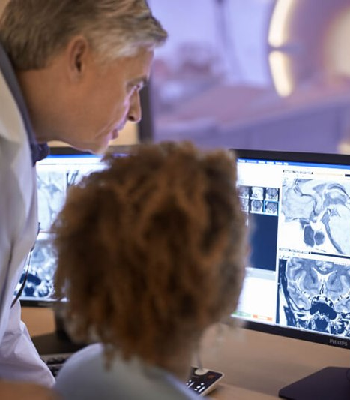

www.acoredu.com

Slide 2


Ashley Etchison, M.D.
Baylor College of Medicine
Houston, Texas

Slide 3

WHAT’S NEW IN
Breast Imaging
Senior Editors:
Dr. Mai A. Elezaby
Dr. He Hongying
Dr. Vilert A. Loving
Dr. Tanya Moseley
Dr. Alexis Nees

Slide 4
Interval Cancers after Negative Supplemental Screening Breast MRI Results in Women with a Personal History of Breast Cancer
Kim, G. R., Cho, N., Kim, S., Han, W., & Moon, W. K.
Goal: Investigate the effectiveness of screening breast MRI in women with a personal history of breast cancer.
Methods: Retrospective review of 6,603 MRI examinations.
Results: Interval cancer rate 1.5 per 1,000 screening examinations, cancer detection rate 8.3 per 1,000 screening examinations, specificity 88.3% and sensitivity 85% for cancer detection.
Conclusion: Supplemental screening breast MRI for women with a personal history of breast cancer is an effective strategy for detecting interval cancers

Slide 5
Digital Mammography and Breast Tomosynthesis Performance in Women with a Personal History of Breast Cancer, 2007–2016
Lee, J. M., Ichikawa, L. E., Wernli, K. J., Bowles, E., Specht, J. M., Kerlikowske, K., . . . Buist, D. S.
Goal: Compare the diagnostic performance of digital and screen-film surveillance mammography (MGM) in women with a personal history of breast cancer.
Methods: Retrospective review of 118,000 surveillance mammograms (digital mammography or digital breast tomosynthesis) between 2007-2016: compared to performance metrics from screen-film mammography collected between 1996-2007.
Results: For digital mammography, interval cancer and cancer detection rates were 3.6 and 8.5 per 1,000 examinations. No significant difference in interval cancer rates between digital MGM and screen-film.
Conclusion: Surveillance MGM for patients with history of breast cancer has not
significantly improved between digital and screen-film MGM.

Slide 6
Screening Mammography Performance Metrics of 2D Digital Mammography Versus Digital Breast Tomosynthesis in Women With a Personal History of Breast Cancer
Chikarmane, S. A., Cochon, L. R., Khorasani, R., Sahu, S., & Giess, C. S.
Goal: Compare diagnostic performance between screening digital breast tomosynthesis (DBT) and full-field digital mammography (FFDM) with personal history of breast cancer.
Methods: Retrospective review of 5,700 FFDM exams between 2014-2016 and 4,400 DBT exams between 2017-2018.
Results: In DBT group, recall rate was significantly lower, and specificity and sensitivity were significantly higher compared to FFDM. Recall rates significantly lower in women with nondense breasts.
Conclusion: Women with nondense breasts and a personal history of breast cancer may benefit from DBT with a greater reduction in false-positive findings.

Slide 7
Diagnostic Performance of Contrast-enhanced Mammography: Comparison With MRI and Mammography
Yüzkan, S., Cengiz, D., Hekimsoy, I., Okçu, Ö S., & Oktay, A.
Goal: Compare diagnostic efficacy of contrast-enhanced mammography (MGM) to conventional MGM and breast MRI.
Methods: Retrospective review of 40 patients with suspicious lesions seen on breast ultrasound between March 2018 and August 2018.
Results: 66% of lesions were malignant. Sensitivities for contrast-enhanced MGM and MRI were significantly higher than conventional MGM (p=0.03). When compared to MRI, contrast-enhanced MGM had a significantly lower false-positive rate (p<0.001).
Conclusion: Contrast-enhanced MGM and MRI had similar diagnostic performance, and both modalities were superior to conventional MGM.

Slide 8
Predicting the pathological grade of breast phyllodes tumors: A nomogram based on clinical and magnetic resonance imaging features
Ma, X., Shen, L., Hu, F., Tang, W., Gu, Y., & Peng, W.
Goal: Investigate clinical and imaging features of breast phyllodes tumors that correlate with pathological grade.
Methods: Review of 182 patients with pathology-proven phyllodes tumors who underwent preoperative breast MRI between January 2015 and January 2020.
Results: 48 patients had malignant lesions. Significantly different features included BI-RADS category, time-signal intensity curve, cystic component, lobulation, intensity on T2 fat saturated MRI imaging, tumor diameter and family history.
Conclusion: Various clinical and imaging features were associated with non-benign breast phyllodes tumors and a prediction normogram may aid in risk assessment.

Slide 9
The diagnostic dilemma with the plateau pattern of the time–intensity curve: Can the relative apparent diffusion coefficient (rADC) optimise the ADC parameter for differentiating breast lesions?
Tang, W., Chen, L., Jin, Z., Liang, Y., Zuo, W., Wei, X., . . . Jiang, X.
Goal: Evaluate diagnostic efficacy of apparent diffusion coefficient (ADC) and relevant ADC (rADC) to distinguish benign and malignant lesions.
Methods: Review of MRI data from 408 patients, including ADC and rADC values of breast lesions, normal breast parenchyma, and pectoralis musculature.
Results: Both ADC and rADC values were significantly different in benign and malignant lesions. Both sensitivity and specificity for lesion ADC and muscle rADC values were similar.
Conclusion: In patients with type II time-intensity curves, lesion ADC and muscle rADC values can assist in differentiating between malignant and benign lesions.

Slide 10




@ACOREdu
@ACOREdu
@ACOREdu
www.acoredu.com

